Slide 1

Module 15
Concurrency
Multithreading

Slide 2
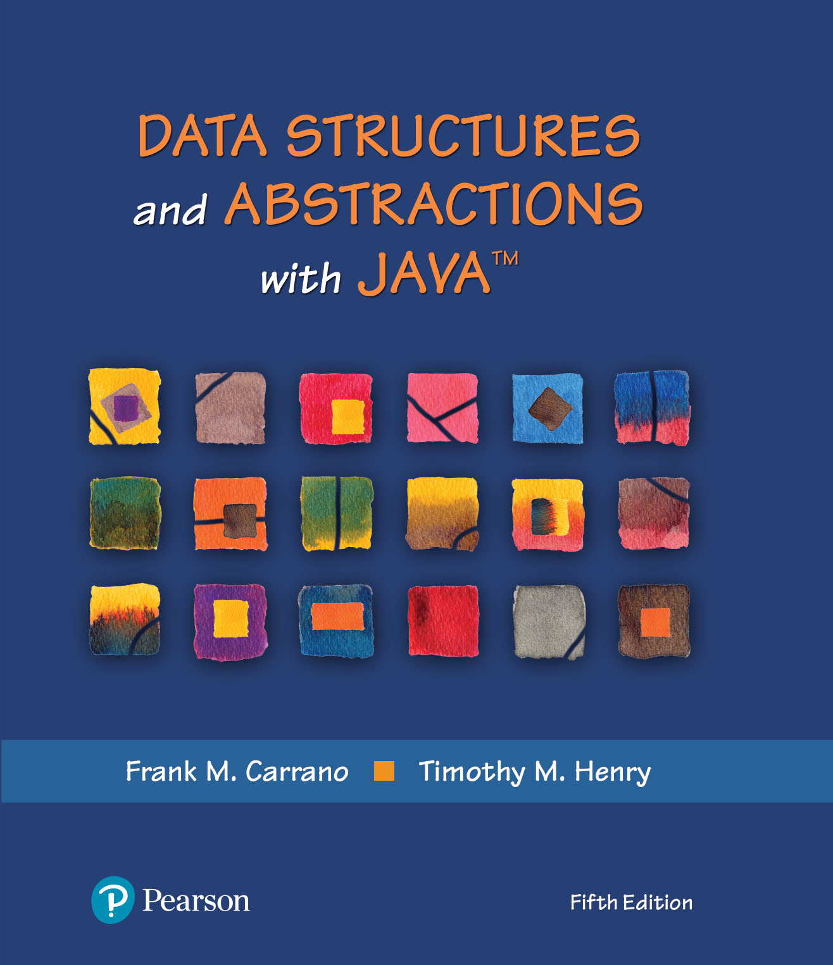
Data Structures and Abstractions with Java™
5th Edition
Module 21 – Concurrency
Multithreading

Slide 3
Module 21
Main topics:
Basic units of concurrency programming
How multiple threads can execute in parallel
Running Threads
Thread Pools
Terminating Threads
Race conditions and deadlocks
Avoid corruption of shared objects by using locks and conditions

Slide 4
Some of the information in these slides was taken from “The Java Tutorials” from Oracle
Oracle tutorial
http://download.oracle.com/javase/tutorial/essential/concurrency/index.html

Slide 5
Lecture Goals
Basic units of concurrency programming
To understand how multiple threads can execute in parallel
To learn how to implement threads
To understand race conditions and deadlocks
To be able to avoid corruption of shared objects by using locks and conditions

Slide 6
Processes and Threads
Two basic units of execution: processes and threads.
In Java, mostly concerned with threads.
A computer system has many active processes and threads.
Single execution core
One thread executing at any given moment.
Processing time for a single core is shared among processes and threads
Multiple processors or processors with multiple execution cores.
Enhances a system's capacity for concurrent execution of processes

Slide 7
Processes
self-contained execution environment.
has a complete, private set of basic run-time resources
has its own memory space.
Some applications are a set of cooperating processes.
most operating systems support Inter Process Communication (IPC) resources, such as pipes and sockets.
IPC is used for communication between processes on the same system, and processes on different systems.
Most implementations of the Java virtual machine run as a single process.

Slide 8
Threads
sometimes called lightweight processes.
processes and threads provide an execution environment
a new thread requires fewer resources than a process
Threads exist within a process
every process has at least one
Threads share the process's resources
memory and open files.

Slide 9
Threads
Every application has at least one
main thread
This thread has the ability to create additional threads
"system" threads
memory management and signal handling
garbage collection

Slide 10
Single Threads
When single-threaded program starts
Has sole control of process until it ends
May wait for user input or I/O operation
Nothing else occurs in JVM
Possible exception of some “system” threads

Slide 11
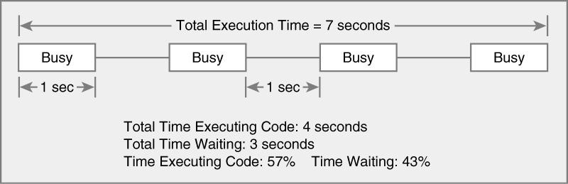
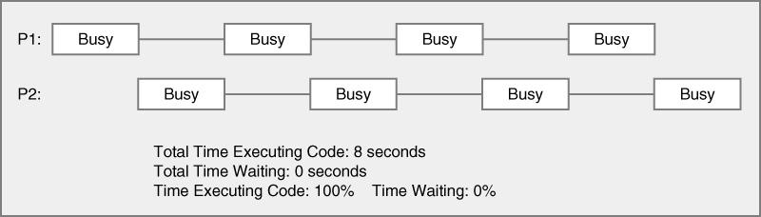
Threads in single execution core
Single Threaded
program
Multi-threaded
The Java Virtual Machine executes each thread in the program for a short amount of time
Mulit-threaded
program
This gives the impression of parallel execution

Slide 12
Thread Scheduler
Operating System feature
runs each thread for a short amount of time (a time slice)
Then the scheduler activates another thread
There will always be slight variations in running times - especially when calling operating system services (e.g. input and output)
There is no guarantee about the order in which threads are executed

Slide 13
Multi-threading
Use threads to improve the performance or responsiveness of your application
May run GUI for your application in 1 thread
May run processor-heavy tasks in 1 thread
May run file manipulation tasks in 1 thread
May run animation in 1 thread

Slide 14
Running a Thread
Create a class that implements the Runnable interface
public interface Runnable { void run(); }

Slide 15
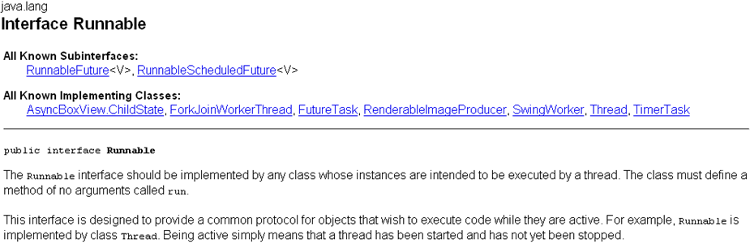
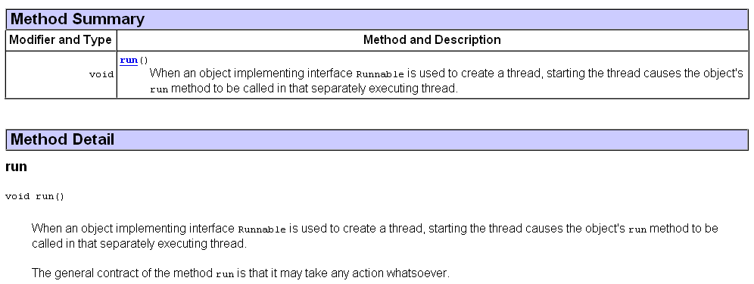

Slide 16
Running a Thread
Place the code for your task into the run method of your class
public class MyRunnable implements Runnable { public void run() { // Task statements go here . . . } }

Slide 17
Running a Thread
Create an object of your subclass
Construct a Thread object from the runnable object.
Call the start method to start the thread.
Runnable r = new MyRunnable();
Thread t = new Thread(r);
t.start();

Slide 18
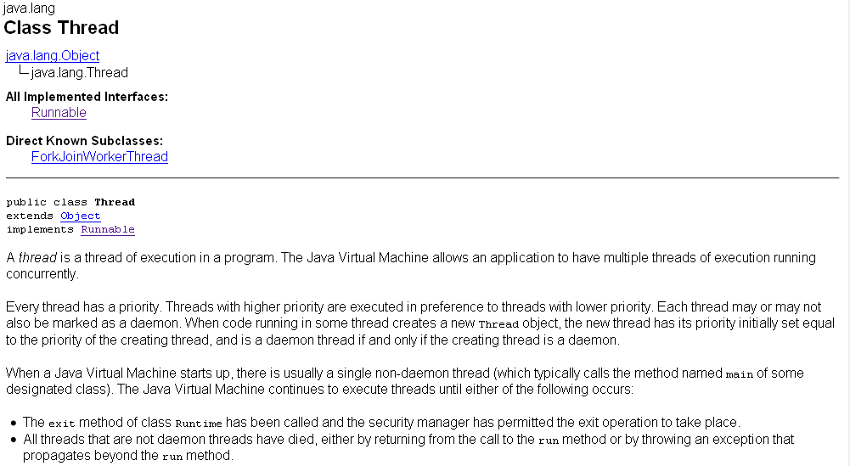
Daemon threads are typically used to perform services for your application. A daemon thread is often called a "service thread" or a "nonessential thread". Usually contain a never-ending loop for the purpose of receiving and handling requests. The other kind of thread is often called a "user thread."
Daemon threads are terminated by the JVM when there are no longer any user threads running, including the main thread of execution.

Slide 19
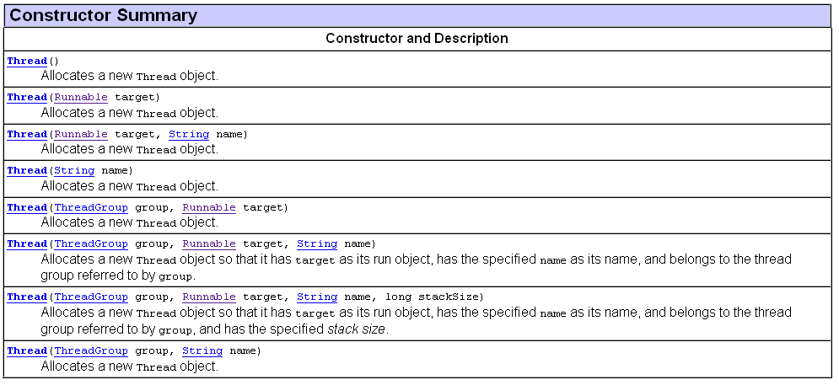

Slide 20
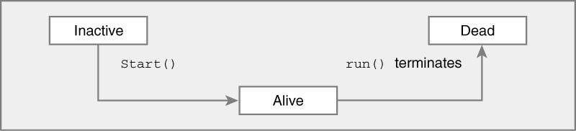
Life of a Thread

Slide 21
Example
A program to print a time stamp and “Hello World” once a second for ten seconds:
Mon Dec 28 23:12:03 PST 2009 Hello, World!
Mon Dec 28 23:12:04 PST 2009 Hello, World!
Mon Dec 28 23:12:05 PST 2009 Hello, World!
Mon Dec 28 23:12:06 PST 2009 Hello, World!
Mon Dec 28 23:12:07 PST 2009 Hello, World!
Mon Dec 28 23:12:08 PST 2009 Hello, World!
Mon Dec 28 23:12:09 PST 2009 Hello, World!
Mon Dec 28 23:12:10 PST 2009 Hello, World!
Mon Dec 28 23:12:11 PST 2009 Hello, World!
Mon Dec 28 23:12:12 PST 2009 Hello, World!

Slide 22
GreetingRunnable Outline
public class GreetingRunnable implements Runnable {
private String greeting;
public GreetingRunnable(String aGreeting) { greeting = aGreeting; } public void run() { Task statements Print a time stamp
Print the greeting
Wait a second } }

Slide 23
GreetingRunnable Outline
public class GreetingRunnable implements Runnable {
private String greeting;
public GreetingRunnable(String aGreeting) { greeting = aGreeting; } public void run() { Task statements Print a time stamp -> Date now = new Date();
Print the greeting -> System.out.println(now + “ “ + greeting);
Wait a second -> Thread.sleep(milliseconds); } }

Slide 24
Terminating Threads
A thread terminates when its run method terminates
Do not terminate a thread using the deprecated stop method
Instead, notify a thread that it should terminate:
t.interrupt();
interrupt does not cause the thread to terminate – it is intended to gets its attention - it sets a boolean variable in the thread data structure. The usual response is for the thread to terminate itself.

Slide 25
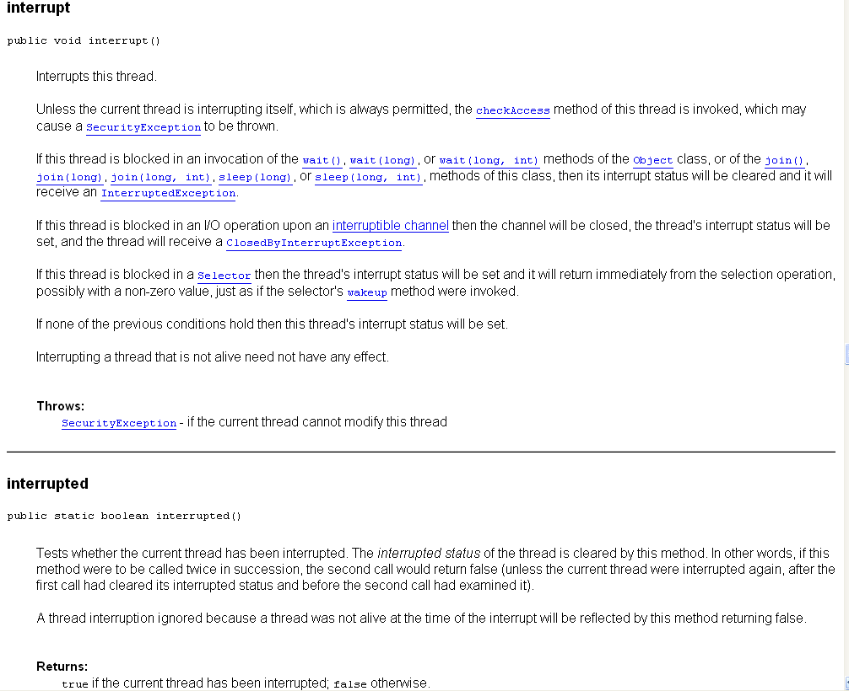

Slide 26
Terminating Threads
The run method should check occasionally whether it has been interrupted
Use the interrupted method
An interrupted thread should release resources, clean up, and exit:
public void run() { for (int i = 1; i <= REPETITIONS && !Thread.interrupted(); i++) { Do work } Clean up }

Slide 27
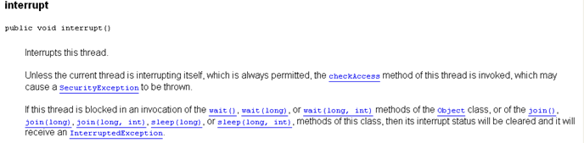
Terminating Threads
The sleep method throws an InterruptedException when a sleeping thread is interrupted
If a sleeping thread is interruped
Catch the exception
Terminate the thread

Slide 28
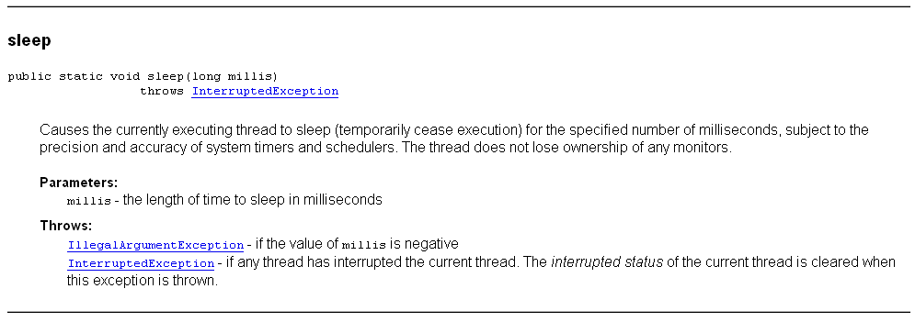
Terminating Threads
The sleep method throws an InterruptedException when a sleeping thread is interrupted

Slide 29
Terminating Threads
public void run()
{
try
{
for (int i = 1; i <= REPETITIONS; i++)
{
Do work
Sleep
}
}
catch (InterruptedException exception)
{ Clean up
return;
}
}

Slide 30
Terminating Threads
Java does not force a thread to terminate when it is interrupted
It is entirely up to the thread what it does when it is interrupted
Interrupting is a general mechanism for getting the thread’s attention

Slide 31
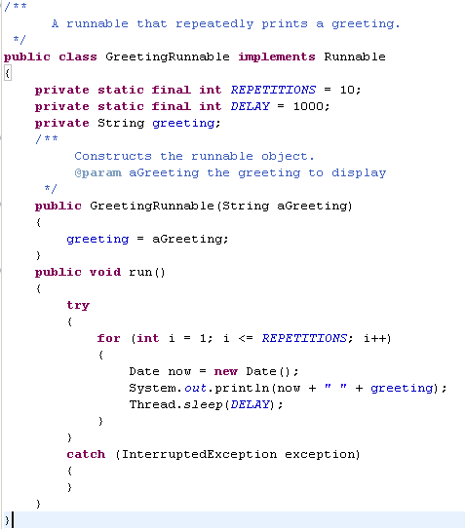

Slide 32
To Start the Thread
Construct an object of your runnable class:
Runnable r = new GreetingRunnable("Hello World");
Then construct a thread and call the start method:
Thread t = new Thread(r); t.start();

Slide 33
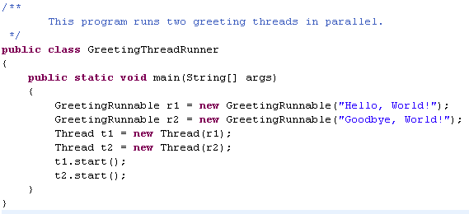

Slide 34


1st run
2nd run

Slide 35
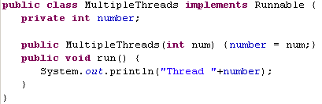
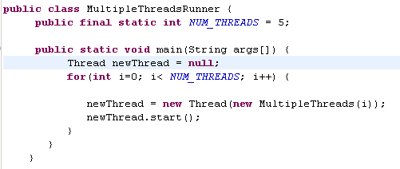
Program to create 5 Threads
Thread 1
Thread 0
Thread 2
Thread 4
Thread 3
Thread 0
Thread 1
Thread 4
Thread 3
Thread 2
Thread 1
Thread 0
Thread 2
Thread 3
Thread 4

Slide 36
What would be the result of the program if the main method called instead of running threads?
r1.run(); r2.run();
public class GreetingThreadRunner
{
public static void main(String[] args)
{
GreetingRunnable r1 = new GreetingRunnable("Hello, World!");
GreetingRunnable r2 = new GreetingRunnable("Goodbye, World!");
Thread t1 = new Thread(r1);
Thread t2 = new Thread(r2);
t1.start();
t2.start();
}
}
Answer: The first call to run would print ten “Hello” messages, and then the second call to run would print ten “Goodbye” messages

Slide 37
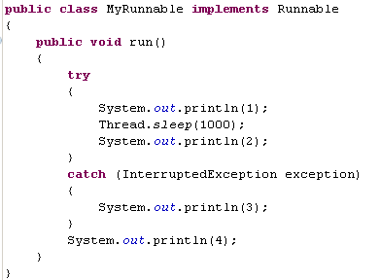
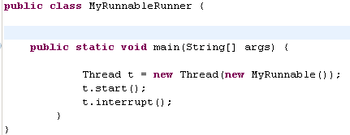
What output is produced?
1
3
4
The call to interrupt merely sets the interruption flag, but the sleep method immediately throws an InterruptedException.

Slide 38
Join
The join method allows one thread to wait for the completion of another. If t is a Thread object whose thread is currently executing
t.join();
causes the current thread to pause execution until t's thread terminates. Overloads of join allow the programmer to specify a waiting period.
However, as with sleep, join is dependent on the OS for timing, so you should not assume that join will wait exactly as long as you specify.
Like sleep, join responds to an interrupt by exiting with an InterruptedException.

Slide 39
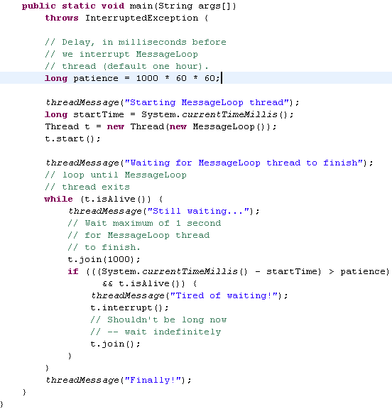
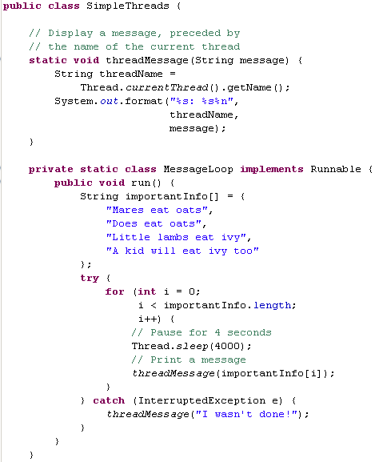

Slide 40
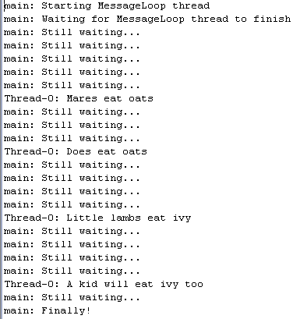

Slide 41
Race Conditions
When threads share a common object, they can conflict with each other
Sample program: multiple threads manipulate a bank account Here is the run method of DepositRunnable:
public void run()
{
try
{
for (int i = 1; i <= count; i++)
{
account.deposit(amount);
Thread.sleep(DELAY);
}
}
catch (InterruptedException exception)
{
}
}

Slide 42
Race Conditions
The WithdrawRunnable class is similar
public void run()
{
try
{
for (int i = 1; i <= count; i++)
{
account.withdraw(amount);
Thread.sleep(DELAY);
}
}
catch (InterruptedException exception)
{
}
}

Slide 43
Sample Application
Create a BankAccount object
Create two sets of threads:
Each thread in the first set repeatedly deposits $100
Each thread in the second set repeatedly withdraws $100
deposit and withdraw have been modified to print messages:
public void deposit(double amount)
{
System.out.print("Depositing " + amount);
double newBalance = balance + amount;
System.out.println(", new balance is "
+ newBalance);
balance = newBalance;
}

Slide 44
Sample Application
The result should be zero, but sometimes it is not
Normally, the program output looks somewhat like this:
Depositing 100.0, new balance is 100.0
Withdrawing 100.0, new balance is 0.0
Depositing 100.0, new balance is 100.0
Depositing 100.0, new balance is 200.0
Withdrawing 100.0, new balance is 100.0
...
Withdrawing 100.0, new balance is 0.0
But sometimes you may notice messed-up output, like this:
Depositing 100.0Withdrawing 100.0, new balance is 100.0, new balance is -100.0

Slide 45
Scenario to Explain Non-zero Result: Race Condition
A deposit thread executes the lines:
System.out.print("Depositing " + amount);
double newBalance = balance + amount; The balance variable is still 0, and the newBalance local variable is 100
The deposit thread reaches the end of its time slice and a withdraw thread gains control
The withdraw thread calls the withdraw method which withdraws $100 from the balance variable; it is now -100
The withdraw thread goes to sleep
Continued

Slide 46
Scenario to Explain Non-zero Result: Race Condition
The deposit thread regains control and picks up where it left off; it executes:
System.out.println(", new balance is " + newBalance);
balance = newBalance; The balance is now 100 instead of 0 because the deposit method used the OLD balance

Slide 47
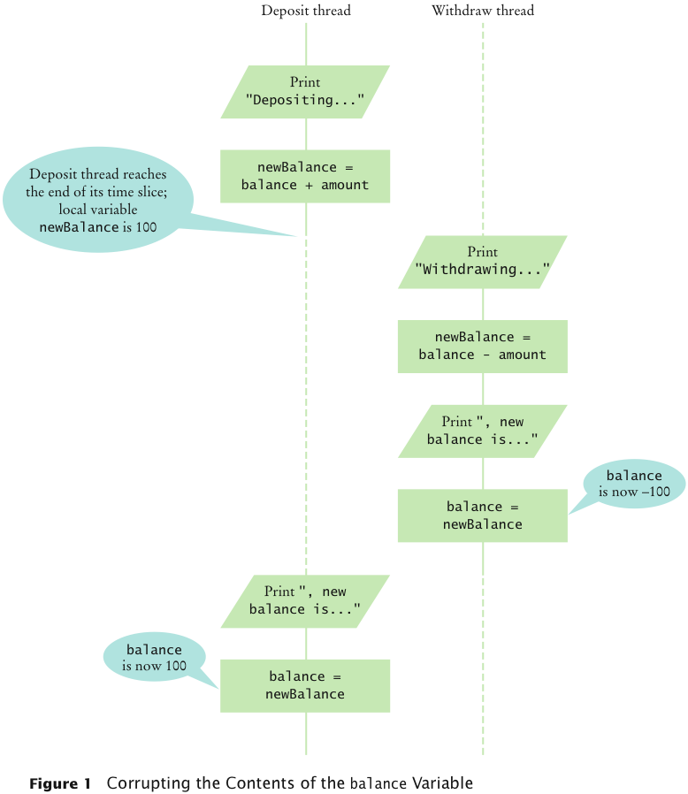
Corrupting the Contents of the balance Variable
public void withdraw(double amount)
{
System.out.print(“withdrawing " + amount);
double newBalance = balance - amount;
System.out.println(", new balance is "
+ newBalance);
balance = newBalance;
}
public void deposit(double amount)
{
System.out.print("Depositing " + amount);
double newBalance = balance + amount;
System.out.println(", new balance is "
+ newBalance);
balance = newBalance;
}

Slide 48
Race Condition
Occurs if the effect of multiple threads on shared data depends on the order in which they are scheduled
It is possible for a thread to reach the end of its time slice in the middle of a statement
It may evaluate the right-hand side of an equation but not be able to store the result until its next turn:
public void deposit(double amount)
{
balance = balance + amount;
System.out.print("Depositing " + amount
+ ", new balance is " + balance);
}
Race condition can still occur:
balance = the right-hand-side value

Slide 49
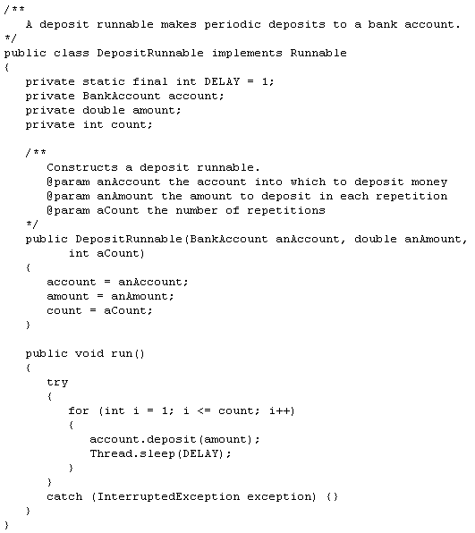

Slide 50
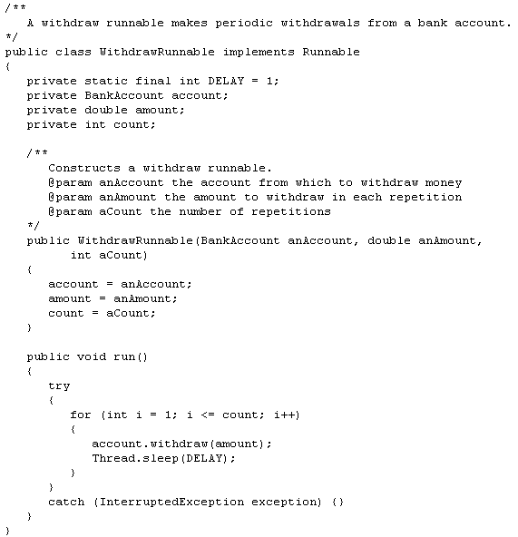

Slide 51
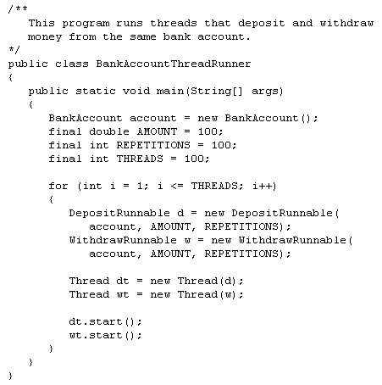

Slide 52
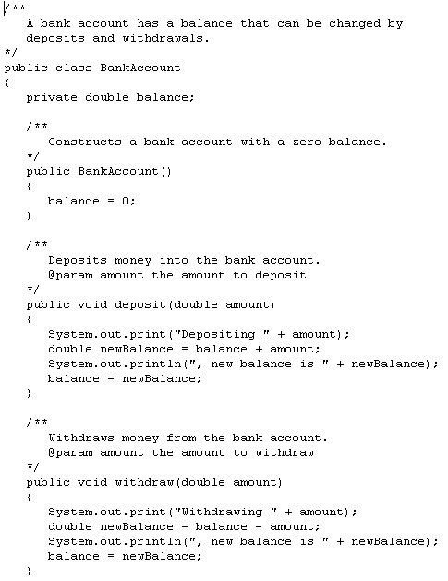
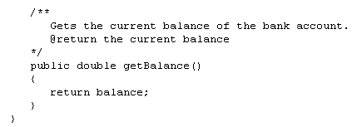

Slide 53
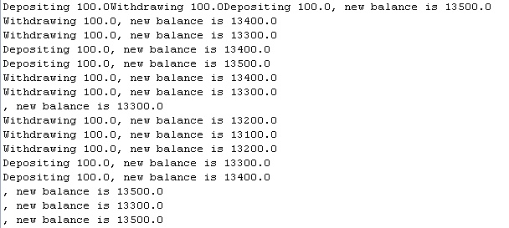

Slide 54
Synchronizing Object Access
To solve problems such as the one just seen, use a lock object
Lock object: used to control threads that manipulate shared resources. Can have Object locks and Class locks.
Object locks – controls whether a method can be run for a particular object. For the method to run it must acquire the lock for the object. Releases the lock when method ends
Class lock – when a thread has a lock for a class, it is the only thread that can execute any of the calls of methods that require a lock.
In Java: Lock interface and several classes that implement it
ReentrantLock: most commonly used lock class
Locks are a feature of Java version 5.0
Earlier versions of Java have a lower-level facility for thread synchronization

Slide 55
Synchronizing Object Access
Typically, a lock object is added to a class whose methods access shared resources, like this: public class BankAccount {
private Lock balanceChangeLock;
public BankAccount() { balanceChangeLock = new ReentrantLock(); ... } ... }

Slide 56
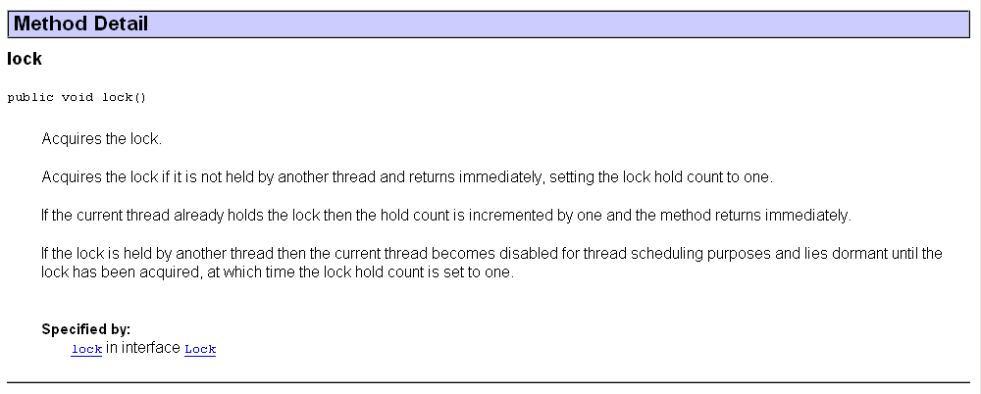
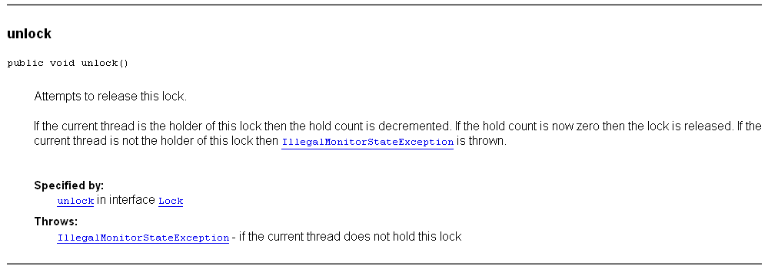

Slide 57
Synchronizing Object Access
Code that manipulates shared resource is surrounded by calls to lock and unlock: balanceChangeLock.lock(); Manipulate the shared resource
balanceChangeLock.unlock();
If code between calls to lock and unlock throws an exception, call to unlock never happens

Slide 58
Synchronizing Object Access
To overcome this problem, place call to unlock into a finally clause: public void deposit(double amount) { balanceChangeLock.lock(); try { System.out.print("Depositing " + amount); double newBalance = balance + amount; System.out.println(", new balance is " + newBalance);
balance = newBalance; } finally
{ balanceChangeLock.unlock(); } }

Slide 59
Synchronizing Object Access
When a thread calls lock, it owns the lock until it calls unlock
A thread that calls lock while another thread owns the lock is temporarily deactivated
Thread scheduler periodically reactivates thread so it can try to acquire the lock
Eventually, waiting thread can acquire the lock

Slide 60
Self Check
If you construct two BankAccount objects, how many lock objects are created?
Answer: Two, one for each bank account object. Each lock protects a separate balance variable.
public class BankAccount {
private Lock balanceChangeLock;
public BankAccount() { balanceChangeLock = new ReentrantLock(); ... } ... }

Slide 61
Self Check
What happens if we omit the call unlock at the end of the deposit method?
Answer: When a thread calls deposit, it continues to own the lock, and any other thread trying to deposit or withdraw money in the same bank account is blocked forever.

Slide 62
Avoiding Deadlocks
A deadlock occurs if no thread can proceed because each thread is waiting for another to do some work first
BankAccount example: public void withdraw(double amount) { balanceChangeLock.lock(); try { while (balance < amount) Wait for the balance to grow ... } finally { balanceChangeLock.unlock(); } }

Slide 63
Avoiding Deadlocks
How can we wait for the balance to grow?
We can’t simply call sleep inside withdraw method; thread will block all other threads that want to use balanceChangeLock
In particular, no other thread can successfully execute deposit
Other threads will call deposit, but will be blocked until withdraw exits
But withdraw doesn’t exit until it has funds available
DEADLOCK

Slide 64
Condition Objects
To overcome problem, use a condition object
Condition objects allow a thread to temporarily release a lock, and to regain the lock at a later time
Each condition object belongs to a specific lock object

Slide 65
Condition Objects (cont.)
You obtain a condition object with newCondition method of Lock interface: public class BankAccount {
private Lock balanceChangeLock; private Condition sufficientFundsCondition;
public BankAccount() { balanceChangeLock = new ReentrantLock(); sufficientFundsCondition = balanceChangeLock.newCondition(); ... } ... }

Slide 66
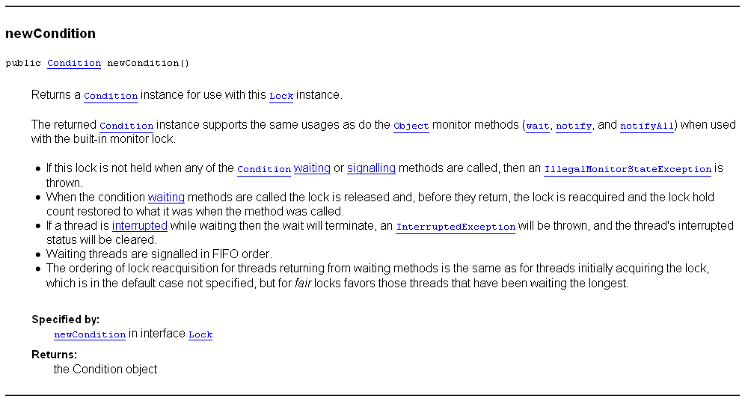

Slide 67
Condition Objects
It is customary to give the condition object a name that describes condition to test
You need to implement an appropriate test

Slide 68
Condition Objects (cont.)
As long as test is not fulfilled, call await on the condition object: public void withdraw(double amount) { balanceChangeLock.lock(); try { while (balance < amount) sufficientFundsCondition.await(); ... } finally { balanceChangeLock.unlock(); } }

Slide 69

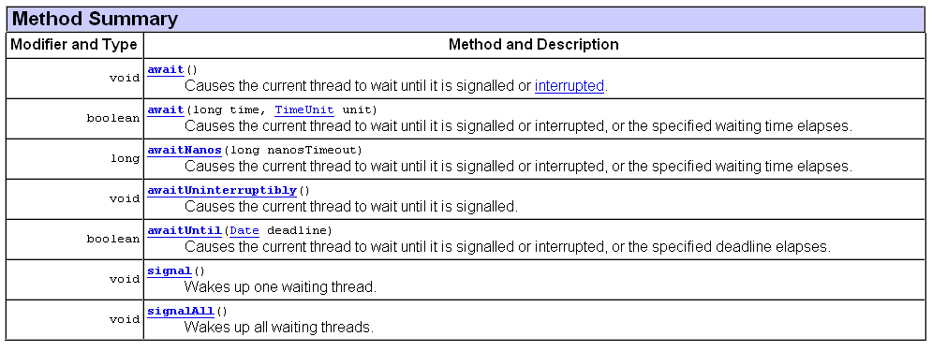

Slide 70
Condition Objects
Calling await
Makes current thread wait
Allows another thread to acquire the lock object
To unblock, another thread must execute signalAll on the same condition object :
sufficientFundsCondition.signalAll();
signalAll unblocks all threads waiting on the condition
signal: randomly picks just one thread waiting on the object and unblocks it
signal can be more efficient, but you need to know that every waiting thread can proceed
Recommendation: always call signalAll

Slide 71


Slide 72
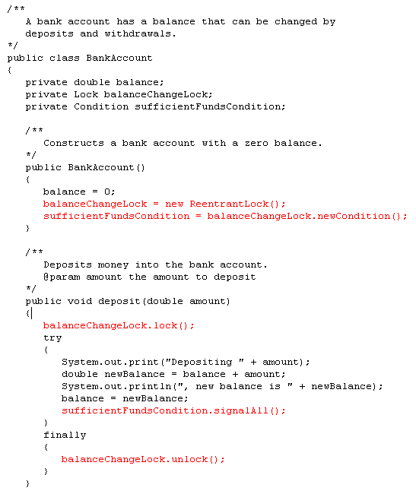

Slide 73
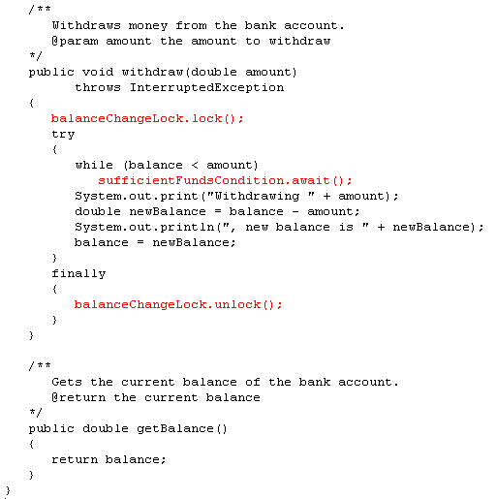

Slide 74
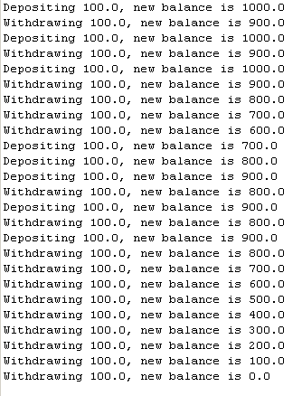

Slide 75
Self Check
What is the essential difference between calling sleep and await?
Answer: A sleeping thread is reactivated when the sleep delay has passed. A waiting thread is only reactivated if another thread has called signalAll or signal.

Slide 76
Self Check
Why is the sufficientFundsCondition object an instance variable of the BankAccount class and not a local variable of the withdraw and deposit methods?
Answer: The calls to await and signal/signalAll must be made to the same object.

Slide 77
An Application of Threads: Animation
Shows different objects moving or changing as time progresses
Is often achieved by launching one or more threads that compute how parts of the animation change
Can use Swing Timer class for simple animations
More advanced animations are best implemented with threads
An algorithm animation helps visualize the steps in the algorithm

Slide 78
Algorithm Animation
Runs in a separate thread that periodically updates an image of the current state of the algorithm
It then pauses so the user can see the change
After a short time the algorithm thread wakes up and runs to the next point of interest
It updates the image again and pauses again

Slide 79
Selection Sort Animation
Review of selection sort:
The smallest value in the array is located and moved to element 0.
Then the next smallest value is located and moved to element 1.
This process continues until all of the elements have been placed in their proper order.
**This example is implemented with Swing, not JavaFX

Slide 80
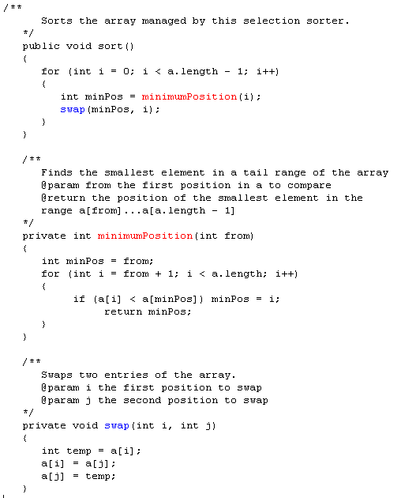

Slide 81
Selection Sort Algorithm Animation
Items in the algorithm’s state
The array of values
The size of the already sorted area
The currently marked element
This state is accessed by two threads:
One that sorts the array, and
One that repaints the frame
To visualize the algorithm
Show the sorted part of the array in a different color
Mark the currently visited array element in red

Slide 82
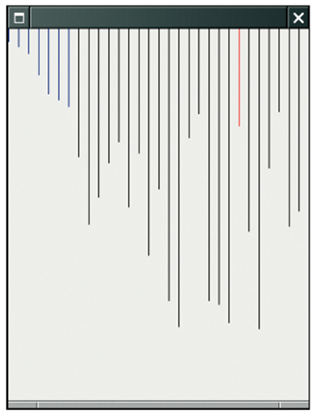
A Step in the Animation of the Selection Sort Algorithm
Current element
Sorted portion

Slide 83
Selection Sort Algorithm Animation: Implementation
Use a lock to synchronize access to the shared state
Add a component (JPanel) instance variable to the algorithm class and set it in the constructor
That instance variable is needed for
Repainting the component, and
Finding out the dimensions of the component when drawing the algorithm state

Slide 84
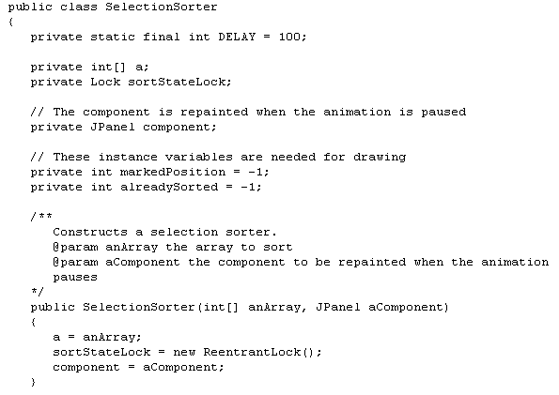
Selection Sort Algorithm Animation: Implementation
. . .

Slide 85
Selection Sort Algorithm Animation: Implementation
At each point of interest, algorithm needs to pause so user can observe the graphical output
We need a pause method that repaints component and sleeps for a small delay: public void pause(int steps) throws InterruptedException { component.repaint(); Thread.sleep(steps * DELAY); }
Delay is proportional to the number of steps involved
pause should be called at various places of interest in the algorithm

Slide 86
Selection Sort Algorithm Animation: Implementation
We add a draw method to the algorithm class
draw draws the current state of the data structure, highlighting items of special interest
draw is specific to the particular algorithm
In this case, draws the array elements as a sequence of sticks in different colors
The already sorted portion is blue
The marked position is red
The remainder is black

Slide 87
Selection Sort Algorithm Animation: draw
public void draw(Graphics2D g2) { sortStateLock.lock(); try { int deltaX = component.getWidth() / a.length; for (int i = 0; i < a.length; i++) { if (i == markedPosition) g2.setColor(Color.RED); else if (i <= alreadySorted) g2.setColor(Color.BLUE); else g2.setColor(Color.BLACK); g2.draw(new Line2D.Double(i * deltaX, 0, i * deltaX, a[i])); } }
finally { sortStateLock.unlock(); } }

Slide 88
Selection Sort Algorithm Animation: Pausing
Update the special positions (marked and already sorted) as the algorithm progresses
Pause the animation whenever something interesting happens
Pause should be proportional to the number of steps that are being executed
In this case, pause one unit for each visited array element
Use sort method

Slide 89
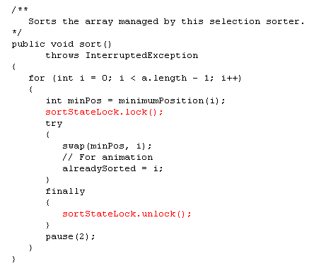
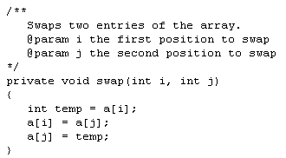

Slide 90
Selection Sort Algorithm Animation: paintComponent
paintComponent calls the draw method of the algorithm object:
public class SelectionSortComponent extends JPanel {
private SelectionSorter sorter;
public void paintComponent(Graphics g) { if (sorter == null) return; Graphics2D g2 = (Graphics2D) g; sorter.draw(g2); } ... }

Slide 91
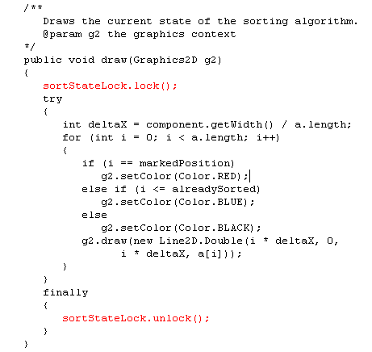

Slide 92
Selection Sort Algorithm Animation: startAnimation
public void startAnimation() { int[] values = ArrayUtil.randomIntArray(30, 300); sorter = new SelectionSorter(values, this); class AnimationRunnable implements Runnable { public void run() { try { sorter.sort(); } catch (InterruptedException exception) { } }
} Runnable r = new AnimationRunnable(); Thread t = new Thread(r); t.start(); }

Slide 93
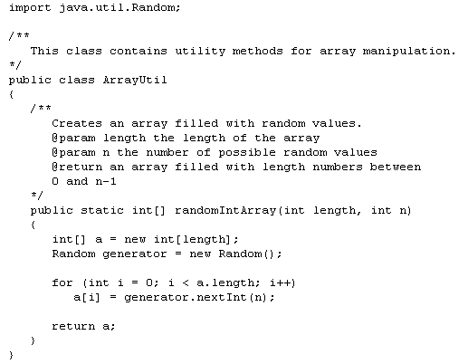

Slide 94
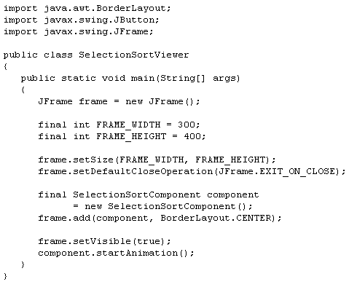

Slide 95
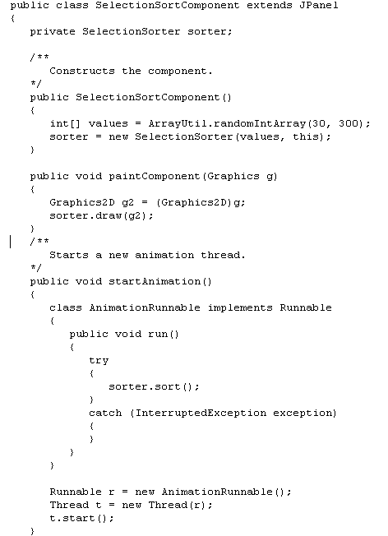

Slide 98
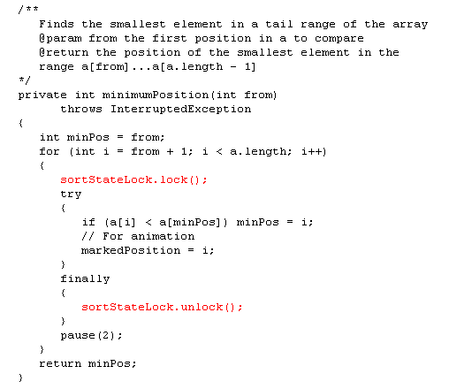

Slide 100
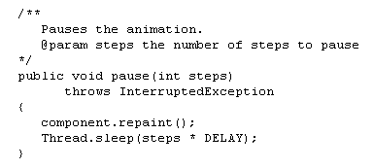

Slide 101
Demo Selection sort:
O:\faculty\Myers\CS204\Lecture 16\Selection Sort

Slide 102
Selection Sort with multiple frames
import java.awt.BorderLayout;
import javax.swing.JButton;
import javax.swing.JFrame;
public class SelectionSortViewer
{
public static void main(String[] args)
{
JFrame frame = new JFrame();
final int FRAME_WIDTH = 300;
final int FRAME_HEIGHT = 400;
frame.setSize(FRAME_WIDTH, FRAME_HEIGHT);
frame.setDefaultCloseOperation(JFrame.EXIT_ON_CLOSE);
final SelectionSortComponent component
= new SelectionSortComponent();
frame.add(component, BorderLayout.CENTER);
frame.setVisible(true);
component.startAnimation();
JFrame frame1 = new JFrame();
frame1.setSize(FRAME_WIDTH, FRAME_HEIGHT);
frame1.setDefaultCloseOperation(JFrame.EXIT_ON_CLOSE);
final SelectionSortComponent component1
= new SelectionSortComponent();
frame1.add(component1, BorderLayout.CENTER);
frame1.setVisible(true);
component1.startAnimation();
}
}
Demo Selection sort – two frames:
O:\faculty\Myers\CS204\Lecture 16\two frames selection sort

Slide 103
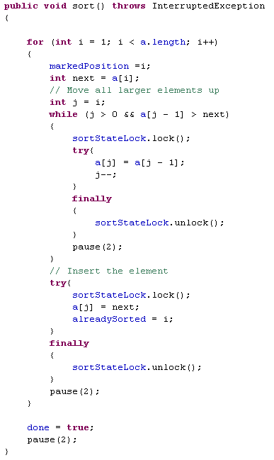
Revised
Original
18 /**
19 Sorts the array managed by this insertion sorter
20 */
21 public void sort()
22 {
23 for (int i = 1; i < a.length; i++)
24 {
25 int next = a[i];
26 // Move all larger elements up
27 int j = i;
28 while (j > 0 && a[j - 1] > next)
29 {
30 a[j] = a[j - 1];
31 j--;
32 }
33 // Insert the element
34 a[j] = next;
35 }
36 }
37 }
Where does the lock need to go?

Slide 104
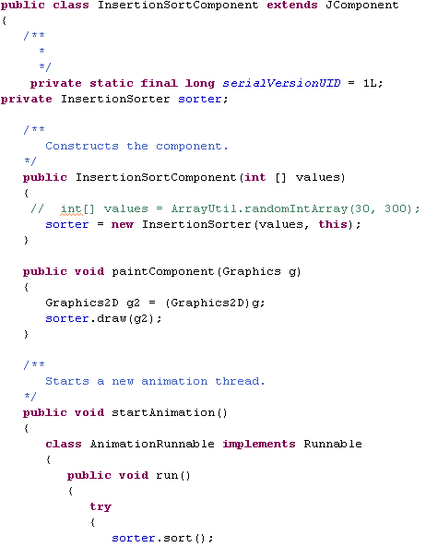
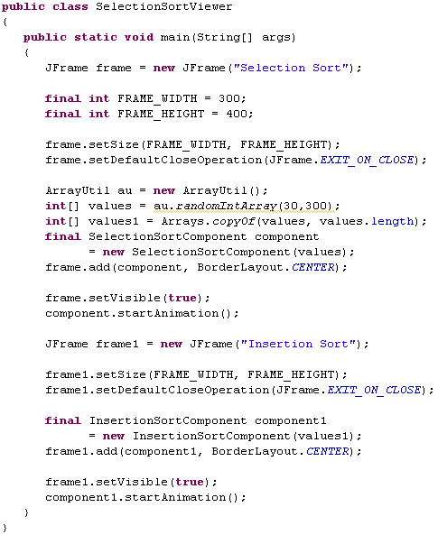
Demo Selection sort and Insertion sort
O:\faculty\Myers\CS204\Lecture 16\two frames selection and insertion-same list

Slide 105
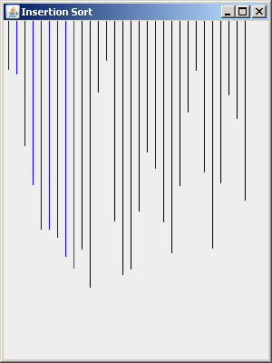
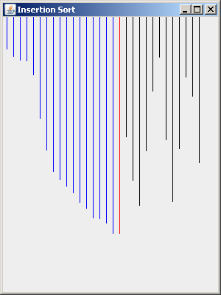

Because of the insertion sort algorithm, it is hard to tell what is being compared when the larger amount gets written over top of the amount to be moved to the correct position
18th element before
18th element during
Moved to correct position

Slide 106


More modifications
The green line shows the portion that is being
moved to the correct position as the values
larger are being moved to the right.
Demo Selection sort and Insertion sort:
O:\faculty\Myers\CS204\Lecture improved selection and insertion

